Slide 2







Outline
ETSI overviews on 5G Standardization
ETSI Building Blocks for 5G Standardization

Slide 3
ETSI overviews on 5G Standardization
Much of the 5G standardization work is done in 3GPP
  Radio access technology for submission to IMT2020 including
  4G/5G radio integration
  Spectrum bands covering <6Ghz and >6Ghz
  Core network technology for submission to IMT2020 including
  Network Slicing & Fixed-Mobile Integration
5G is also expected to integrate non-3GPP access technologies, e.g. Wi-Fi, wireline, non-terrestrial networks (e.g. satellite, HAPS)

Slide 4
ETSI Building Blocks for 5G Standardization
ETSI has several activities that are developing requirements and potential enablers/building blocks for a 5G system
  Technical Committees (TCs)
  Industry Specification Groups (ISGs)
Technical Committees (TCs):
TC BRAN – Broadband Radio Access Networks:
  5GHz and 60 GHz RLAN Technologies
  TV White Space Harmonized Standard
TC CABLE
  Standardization of integrated broadband cable telecommunication network technology, the foundation for widely available, high capacity wired data networks,
  analyzing the potential of cable networks for backhaul and fronthaul of 5G signals and additional requirements resulting from this use case, and leveraging 5G architecture and interfaces for fixed-mobile convergence in the context of cable networks
TC CYBER
  To ensure the security of the 5G network, devices and infrastructure from inception, service, improvement and end of life including detailed security work within 5G groups
5G & ETSI
3GPP
ETSI ISGs
oneM2M
ETSI TCs

Slide 5
ETSI Building Blocks for 5G Standardization
Technical Committees (TCs) contd:
TC CYBER QSC – Quantum Safe Cryptography
  QSC is fundamentally the security approach to next-generation computing, an is extremely appropriate for certain components of the new 5G architecture and is Creating and selecting cryptographic techniques that are resistant to attack by next-generation quantum computers.
TC DECT
  Developing a new DECT-2020 air interface, which is planned to fulfil the IMT-2020 requirements
TC eHealth
  All aspects of 5G capability and potential that are relevant to eHEALTH issues and the role of 5G will considerably expand and significantly improve the environment for IoT and cloud services for all areas of medicine and health.

Slide 6
ETSI Building Blocks for 5G Standardization
Technical Committees (TCs) contd:
TC INT/AFI – Core Network and Interoperability Testing
  5G PoC Multi-Demos Series Program/Project on ETSI GANA (Generic Autonomic Networking Architecture): Autonomics in 5G Network Slices Creation, Autonomic & Cognitive Management & E2E Orchestration;
  Closed-Loop (Autonomic) Service Assurance of IoT 5G Slices Use Cases;
  Integration & Testing of Autonomics Software for Self-Adaptive Nets
TC ITS – Intelligent Transport Systems
  Vehicle connectivity with the capability of using a 5G infrastructure
TC LI – Lawful Interception
  Development of a suite of standards allowing ETSI standards to support industry compliance to the requirements of national and international law - touches many 5G aspects.

Slide 7
ETSI Building Blocks for 5G Standardization
Technical Committees (TCs) contd:
TC MSG – Mobile Standards Group
  Along with its joint task force with ERM (EMC and Radio Spectrum Matters) and is responsible for the development of European Standards to be used for presumption of conformity for 5G equipment
TC MTS - Methods for Testing and Specification
  Responsible for the identification and definition of advanced specification and testing methods to improve the efficiency and economics of the standard description and associated conformance/interoperability testing processes.
  Provisioning and evolution of standardized test languages allowing harmonized test specification, e.g. TTCN-3 – Testing and Test Control Notation Version 3 and TDL – Test Description Language, which are essential pieces for testing 5G networks

Slide 8
ETSI Building Blocks for 5G Standardization
Industry Specification Groups (ISGs):
ISG ARF – Augmented Reality Framework
  Developing an interoperability framework for Augmented Reality components, systems and services and 5G will significantly improve network performance for cloud services in particular in terms of bandwidth and latency
ISG ENI – Experiential Networked Intelligence
  The assessment of Networked Experience using Artificial Intelligence in 5G communications systems
ISG IP6 – IPv6 Integration
  Addressing the transition from IPv4 to IPv6, defining best practices, garnering support and creating awareness of the impact of IPv6 on critical infrastructure and on emerging topics which encompass a 5G infrastructure, such as IoT (Internet of Things) and SDN/NFV (Software Defined Networking/Network Function Virtualization)

Slide 9
ETSI Building Blocks for 5G Standardization
Industry Specification Groups (ISGs) Contd:
ISG mWT – mm Wave Transmission
  Identification of spectrum regulations and licensing scheme more suitable and sustainable with respect to current ones in order to better match the challenging requirements of 5G mainly in terms of capacity increase;
  Facilitating the use of the V-band (57-66 GHz) for Fixed Wireless Access, E-band (71-76 & 81-86 GHz) and in the future higher frequency bands above 100 GHz (i.e. W/D-Band) for large volume applications in the back-hauling and front-hauling to support 5G deployment;
ISG NFV – Network Functions Virtualisation
  Reviewing and identifying opportunities for an evolution of networking architectures and protocols to enhance 5G network implementation and performance.

Slide 10
ETSI Building Blocks for 5G Standardization
Industry Specification Groups (ISGs) Contd:
ISG NGP - Next Generation Protocols
  ISG NGP studies the implementation of the TCP/IP protocol suite and 3GPP protocols in LTE to identify issues which need to be addressed in support of 5G systems development and standardisation, and technology which would help to resolve those issues
ISG ZSM - Zero touch network and Service Management
  Specification of modular, flexible, scalable and extensible service-based management architecture framework and solutions to enable full end-to-end orchestration and automation of 5G network and services
ISG MEC – Multi-Access Edge Computing
  In detail, following slides..

Slide 11
Multi-access Edge Computing (MEC)
MEC offers application developers and content providers cloud-computing capabilities and an IT service environment at the edge of the network.
Scope of the 5G-related activity:
  MEC is a key enabler for a significant number of 5G use cases especially as defined by NGMN and 3GPP SA
  Moreover, with a scope now expanded to consider multi-access edge computing, MEC is well positioned as a key contributor to fixed-mobile integration
  Like NFV, MEC also defines architecture and APIs for management of MEC compute infrastructure.
  Additionally, MEC also defines APIs for several services such as Radio Network Information Service (RNIS) and Location Service

Slide 12
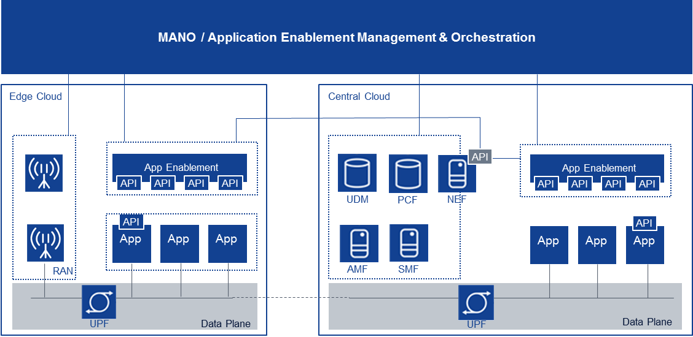



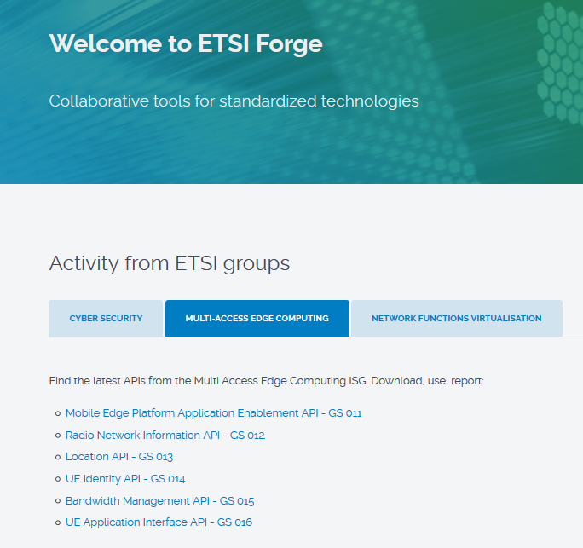

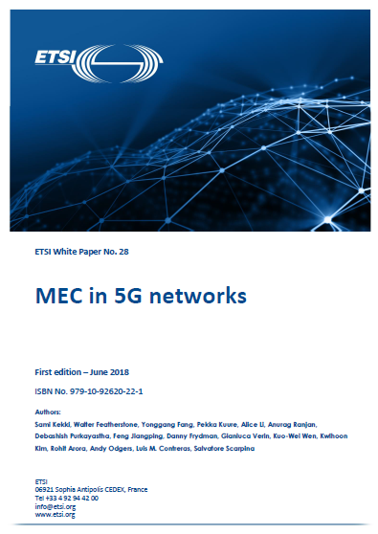

What ETSI MEC has achieved
Foundation for Edge Computing created – Fully standardized solution to enable applications in distributed cloud created by ETSI MEC + 3GPP
API Framework
Selection & re-location of UPF
API Principles & Guidelines
+
AF influence on traffic routing
=
Service exposure via standardized APIs
Mobility event notifications from SMF
Management & Orchestration of Applications
Concurrent access to local and central DN
82 members - Operators – Technology Vendors – IT players – Application developers
ETSI MEC published related specifications are available here>>

Slide 13
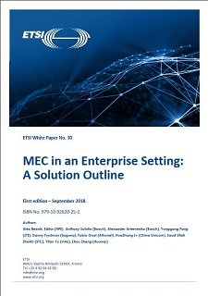
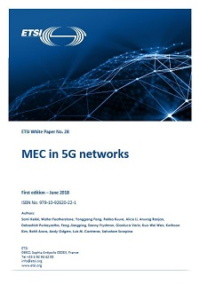
MEC White Papers
MEC White Papers
  MEC in an Enterprise Setting https://www.etsi.org/images/files/ETSIWhitePapers/etsi_wp30_MEC_Enterprise_FINAL.pdf
  MEC deployment in 4G and towards 5G: http://www.etsi.org/images/files/ETSIWhitePapers/etsi_wp24_MEC_deployment_in_4G_5G_FINAL.pdf
  CRAN and MEC: A Perfect Pairing: http://www.etsi.org/images/files/ETSIWhitePapers/etsi_wp23_MEC_and_CRAN_ed1_FINAL.pdf
  Developing SW for MEC http://www.etsi.org/images/files/ETSIWhitePapers/etsi_wp20_MEC_SoftwareDevelopment_FINAL.pdf
  MEC in 5G Networks: http://www.etsi.org/images/files/ETSIWhitePapers/etsi_wp28_mec_in_5G_FINAL.pdf

Slide 14
ETSI MEC work (Phase 2)
MEC Phase 2 – Study Item MEC in 5G (MEC 031)
  The ETSI MEC white paper on MEC in 5G networks sets the scene for this new study item - investigate the opportunities offered to MEC by the 5G system and its edge computing enablers
  The scope includes:
    C-plane interactions with 5GC,
    functional split between MEC and 5GC wrt. API framework,
    organization of MEC as an AF,
    pertinent interactions of MEC with (R)AN
PCF
NSSF
PCF
NSSF
NRF
NRF
UDM
UDM
NEF
NEF
MEC System
System Level
System Level
MEC Orchestrator
MEC Orchestrator
AMF
AUSF
AMF
AUSF
SMF
SMF
PCF
PCF
Distributed Host Level
N4
Distributed Host Level
N9
APP
APP
Service
UPF
Service
UPF
MEC Platform Manager
Service
MEC Platform Manager
Service
MEC Platform
N6
MEC Platform
UE
N6
UE
(R)AN
(R)AN
Virtualization Infrastructure
Service
Virtualization Infrastructure
Service
Data Network (LA/DN)

Slide 15

Now in 2nd 3-year Phase of work
Key overall specification
  Technical Requirements (MEC 002)
  Framework and Reference Architecture (MEC 003)
  MEC Proof of Concept (PoC) Process (MEC-IEG 005)
  API Framework (MEC 009)
IaaS Management APIs
  Platform mgmt. (MEC 010-1)
  Application mgmt. (MEC 010-2)
  Device-triggered LCM operations (MEC 016)
PaaS Service Exposure
  Required Platform Svcs / App. Enablement (MEC 011)
  Service APIs (MEC 012, 013, 014, 015)
Key Studies for Future Work
  Study on MEC in NFV (MEC 017)
  Study on Mobility Support (MEC 018)
Evolution of Phase 1 and closing open items
  Application Mobility (MEC 021)
  Lawful Intercept (MEC 026 - published)
Addressing key Industry Segments
  V2X (MEC 022 - published, MEC 030)
  IoT (MEC 033), Industrial Automation, VR/AR
Key use-cases and new requirement
  Network Slicing (MEC 024)
  Container Support (MEC 027)
Normative work for integration with NFV
  Incorporate in v2 of existing specs as needed
From “Mobile” to “Multi-Access”
  Wi-Fi (MEC 028)
  Fixed Access (MEC 029 - published)
MEC integration in 5G networks (MEC 031)
Developer community engagement
  API publication through ETSI Forge (more overleaf)
  Hackathons
Testing and Compliance (MEC 025 - published, MEC 032)
ETSI MEC phase 1 (Completed)
ETSI MEC phase 2 (in Progress)

Slide 16
conclusion
Whilst there is a wide variety of use cases driving 5G, and a variety of priorities and timescales across various industrial and governmental stakeholders, standardization is primarily industry-driven, reflecting business opportunities.
ICT Standards need to be global considering the fact of interoperability, Avoid fragmentation, develop together or adopt Standards/Specification
  Several Standards organizations (including ETSI) are developing potential building blocks of an overall 5G system
  ETSI interacts with many of these, and with TSDSI it has a Cooperation Agreement
  5G Standardisation is and will be done at 3GPP
  Building Blocks/local requirement shall be tabled at 3GPP as it is the place for SDOs to work together and table their requirements

Slide 17

Dinesh Chand Sharma
(Seconded European Standardization Expert in India)
Director – Standardization & Public Policy
SESEI C/O EBTC, DLTA Complex, Gate No 3, 1st Floor, 1, Africa Avenue, New Delhi 110029
Mobile: +91 9810079461, Tel: +91 11 3352 1525, dinesh.chand.sharma@sesei.eu
www.sesei.eu ⬄ www.sesei.in

